Slide 1
Basic Cryptographic Primitives behind Blockchain Technology
Cryptographically Secured Hash Functions
Digital Signatures
Hash Functions: It is used to connect the “Blocks” in a chain in a temper-proof way
Digital Signatures: Digitally sign the data so that no one can “deny” about their activities. Also, other can check whether person (or node) is authentic or not

Slide 2
Cryptographically Secured Hash Functions
  Map any sized data to a fixed size
  Take an arbitrarily sized string as input
  Input M: The Message
  Produce fixed size output
  Output H(M): Message Digest
  Requirement: Efficiently computable

Slide 3
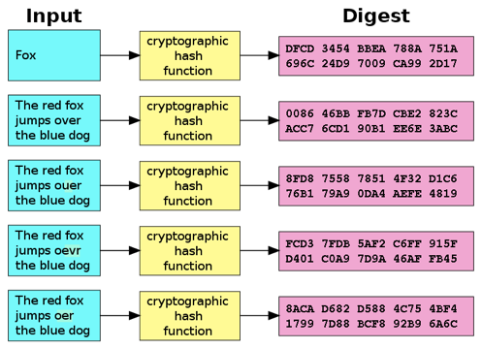
Contd..
Examples: MD5, SHA256.
Avalanche effect- A small change in the data results in a significant change in the output.
=-=-=-==-==-=-=-=-=-=-=-=-=-=-=-=-=-==-=-=-==-=-==-=-=-=-=-=-=-=-=-=-=-==-=
http://www.blockchain-basics.com/HashFunctions.html

Slide 4
Properties of Hash Functions
    One-way Function: Given a message M, it is easy to find H(M). However, given H(M), one cannot find M
    Deterministic: Always produce the identical hash value for the identical input data
    Collision-Free: If two messages are different, then their digests also differ. It means that for two different x₁ and x₂, H(x₁) and H(x₂) should be different.
    Hiding: Hide the original message; Remember the “Avalanche Effect”
    Puzzle-friendly: Given X and Y, find out value of k such that
    Y=H(X || k).
    =-==-=-=-=-==-=-=-=-=-=-=-==-=-==-=-=-==-=-==-=-=-=-==-=-==-=-=-=-Puzzle-friendly property is used to solve the mining puzzle problem in Bitcoin Proof-of-Work

Slide 5
Contd..
Collision-Free
It is difficult to find x and y, where x is not equal to y. But, H(x) = H(y)
It means that if two message digest are same, then it is safe to assume that their messages are also same.
i.e.
if H(x) = H(y)
then x=y
=-=-=-==-=-==-=-==-=-=-=-=-=-==-=-=-=-==-=-=-=-=-=-=-=-=-==-=-=-=-=-=-=-=-=-
Therefore, if anyone want to compare and check, whether two messages are same or not, it is required to compare their digest. Because, the size of the digest is significantly less than the size of the original message.

Slide 6
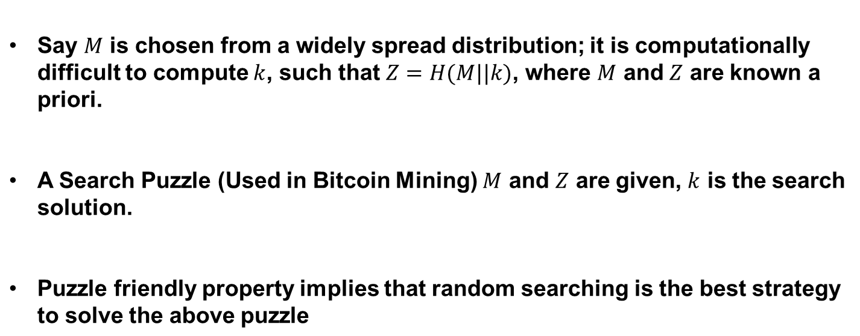
Contd..
(Puzzle Friendly property)

Slide 7
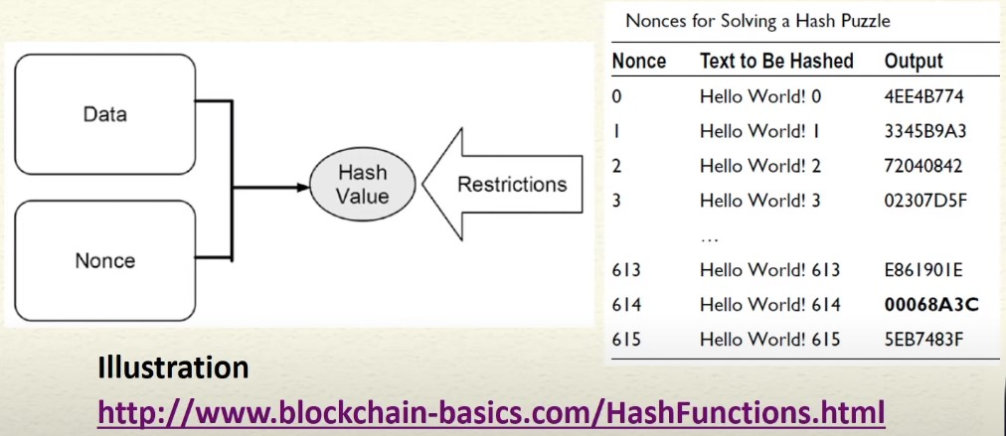
Contd..

Slide 8
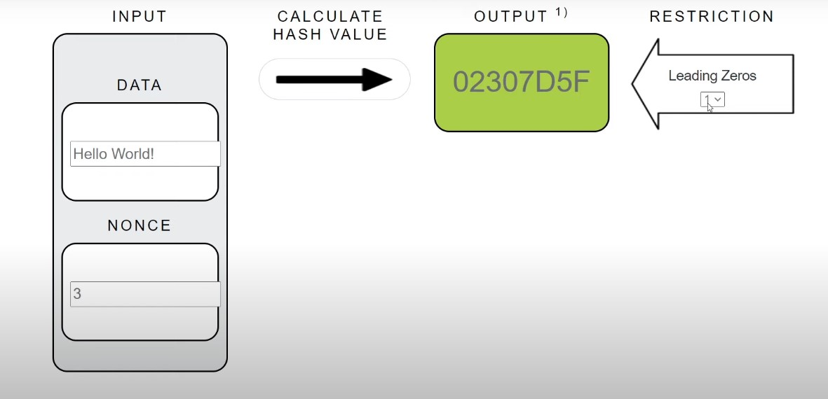
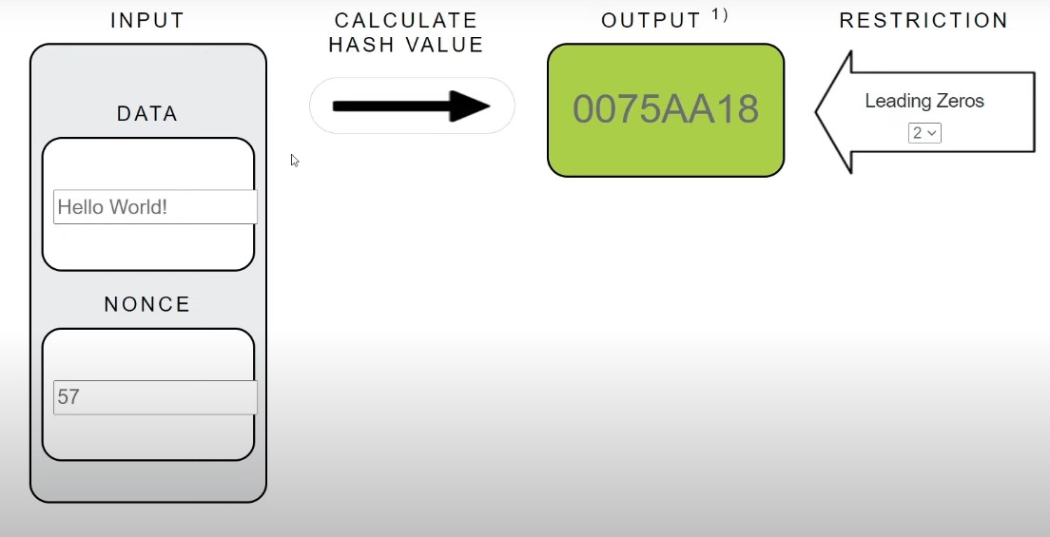
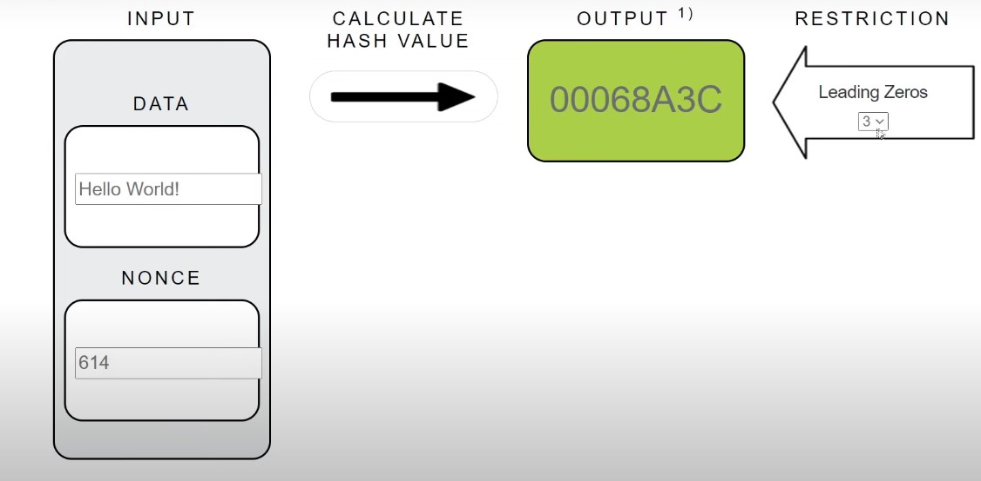
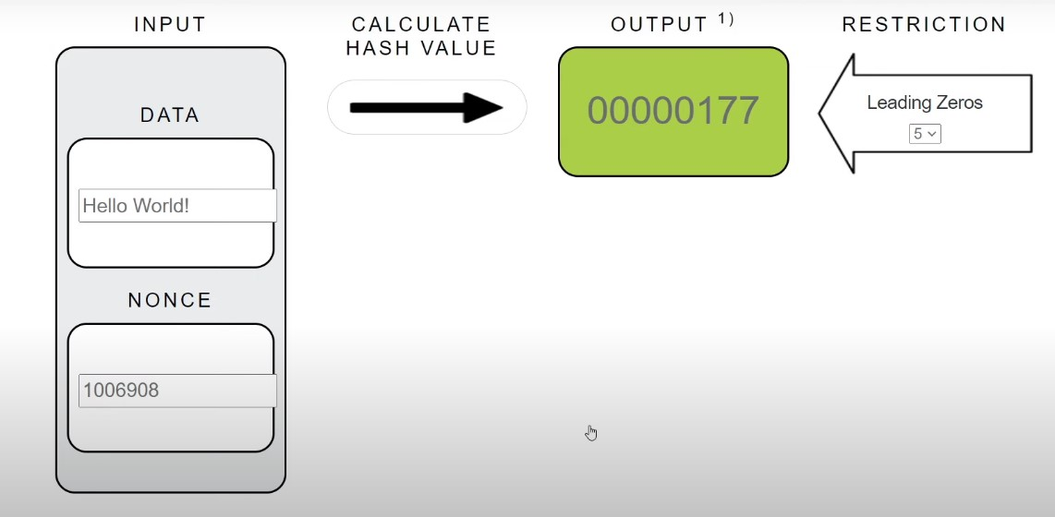
Contd..
Puzzle (a)
Puzzle (b)
Puzzle (c)
Puzzle (d)

Slide 9
Cryptographically Secured Hash Functions
Keywords:
SHA256 is used in Bitcoin mining – to construct the Bitcoin blockchain.
Hash functions are used to connect the blocks in the blockchain.
Puzzle Friendly property of hash function is used in the blockchain.

Slide 10
Digital Signature
A digital code, which can be included with an electronically transmitted document to verify
  The content of the document is authenticated.
  The identity of the sender.
  Prevent non-repudiation – sender will not be able to deny about the origin of the document

Slide 11


Contd..
Digital Signature using Public Key Cryptography:
Sign the message using the Private key.
Verify the signature using the Public key.
Sign the message with alice private key
M’ = E(M,K)
Verify the message with alice public key
M = E(M’ , K’)
M,M’
K = private key
K’ = public key
Alice
Bob

Slide 12
Contd..
Digital Signature in blockchain:
Used to validate the origin of a transaction
Prevent non-repudiation
    Alice can not deny her own transactions.
    No one else can claim Alice’s transaction as his/her own transaction
Bitcoin uses Elliptic Curve Digital Signature Algorithm (ECDSA).

Slide 13
Blockchain Fundamentals (Contd..)
Hash Pointer:
A Cryptographic Hash Pointer is a pointer to a location where
    some information is stored.
    hash of the information is stored.
With the hash pointer, we can
    Retrieve the information.
    Check that the information has not been modified (by computing the message digest and then matching the digest with the stored hash value).

Slide 14
Blockchain Fundamentals (Contd..)
Simplified look of the Hash Pointer:
H(DATA)
DATA
Hash Pointer

Slide 15
Blockchain Fundamentals (Contd..)
Hashchain:
H(D^{(i-1)})
H(D^{(i)})
H(D^{(i+1)})
D^{(i)}
D^{(i+1)}
D^{(i+2)}
Can be used to detect whether data is tampered or not?

Slide 16

Blockchain Fundamentals (Contd..)
Merkle Tree:
It is also known as hash tree.
Every leaf node is labelled with the hash of a data block.
Every non-leaf node is labelled with the cryptographic hash of the labels of its child nodes
Root Hash
H_{root}=Hash(H₀+H₁)
L₁ Hash
H₀= Hash(H₀₀+H₀₁)
L₁ Hash
H₁=Hash(H₁₀+H₁₁)
L₂ Hash
H₀₀=Hash(D₁)
L₂ Hash
H₀₁=Hash(D₂)
L₂ Hash
H₁₀=Hash(D₃)
L₂ Hash
H₁₁=Hash(D₄)
D1
D2
D3
D4

Slide 17
Structure of a Block in the blockchain:
A block is a container data structure that contains a series of transactions.
Two components:
    Block header
    Block body

Slide 18
Structure of a Block in the blockchain (Contd..)
Block header
Block header consists :
Previous block hash
Mining statistics used to construct the block (Nonce, Difficulty-target, Time-stamp)
Merkle tree root
H0
H1 = Hash(H0)
H2 = Hash(H1)
H3 = Hash(H2)
Keyword:
Previous block hash is used to construct the blockchain temper-proof.
H4 = Hash(H3)

Slide 19
Structure of a Block in the blockchain (Contd..)
Block body
Block body consists of list of transaction.
The merkle tree is created based on the transaction and the merkle root is stored in the block header for further computation.

Slide 20
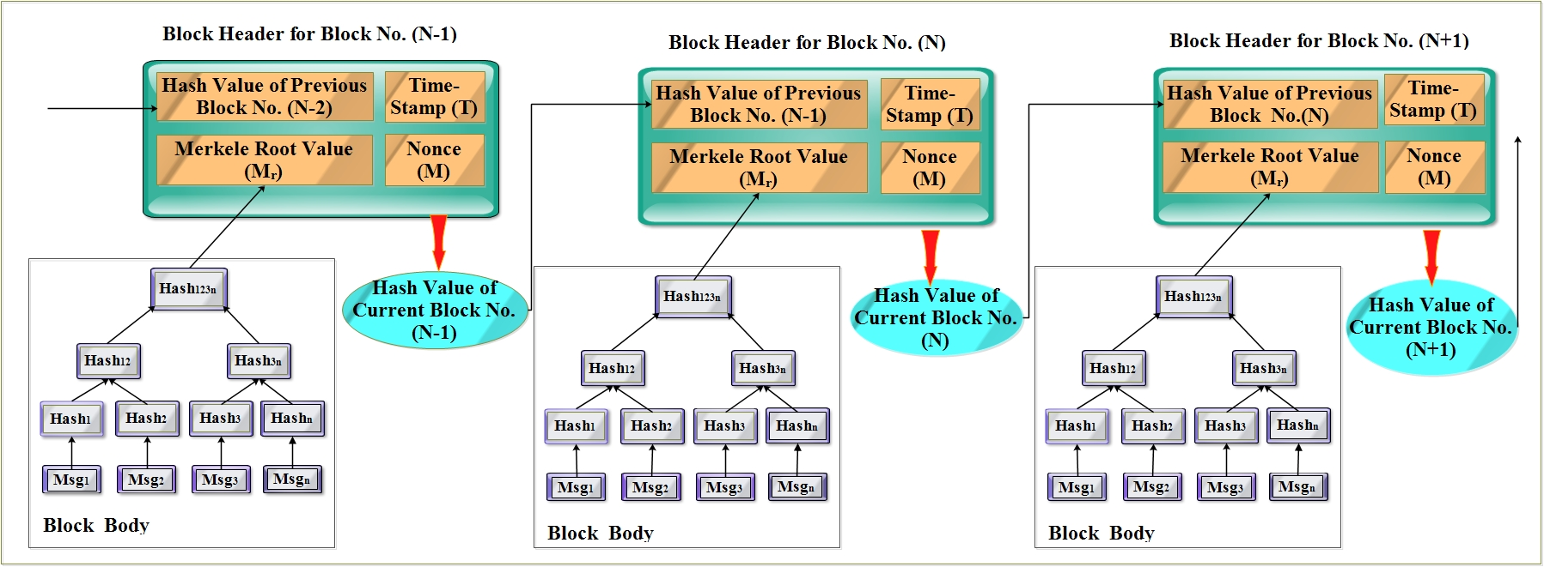
Block structure and merkle tree:

